Slide 1

Report Writing & Referencing
It’s easier than you think!

Slide 2

Who likes writing reports?
Who likes referencing?

Slide 3

What are learning?
Report Structure
Academic Reports vs. Technical Reports
Using Images
Plagiarism!
Referencing
General Advice
Activities
Questions

Slide 4

Report Structure
Cover Pages

Slide 5

Report Structure
Abstract/Executive Summary

Slide 6
Report Structure
Contents Page

Slide 7
Report Structure
Introduction

Slide 8
Report Structure
Methods
Results
Discussion

Slide 9
Report Structure
Conclusion & Recommendations

Slide 10
Report Structure
References

Slide 11
Report Structure
Appendices/Appendix

Slide 12
Academic Reports vs. Technical Reports

Slide 13
Using Images
Pictures
Graphs
Examples

Slide 14
Plagiarism
And how to avoid it!

Slide 15
Referencing - Types
APA 6/7
MLA
Chicago/Turabian
IEEE

Slide 16
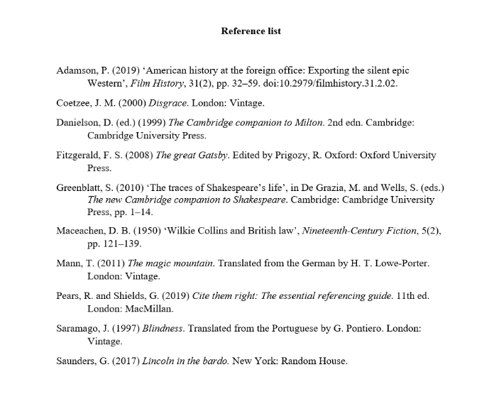
Referencing – APA7
(Caulfield, 2020)

Slide 17
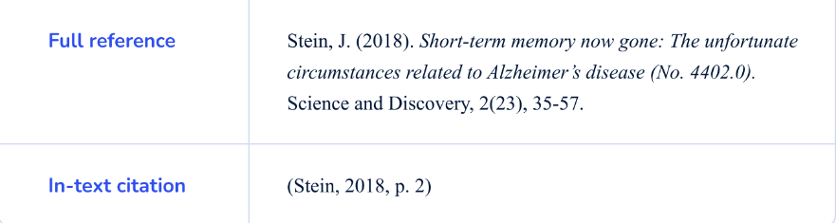
Referencing APA7
In-text Referencing - Quotes
(Flores, 2023)

Slide 18
General Advice for Writing Reports
Start early! Break it up!
Proofread later
Refer to your handouts
Stick to the scope
Reference as you go
Get Feedback
Have a back up
Format, format, format!

Slide 19
What are we doing next?
Create a report template
Referencing practice

Slide 20

Questions

Slide 21
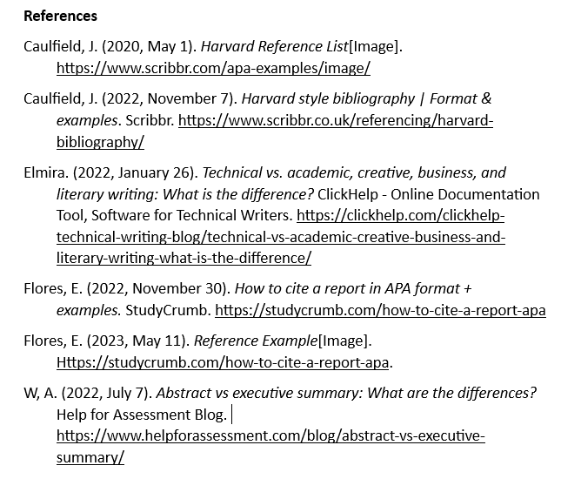
References

